Slide 1
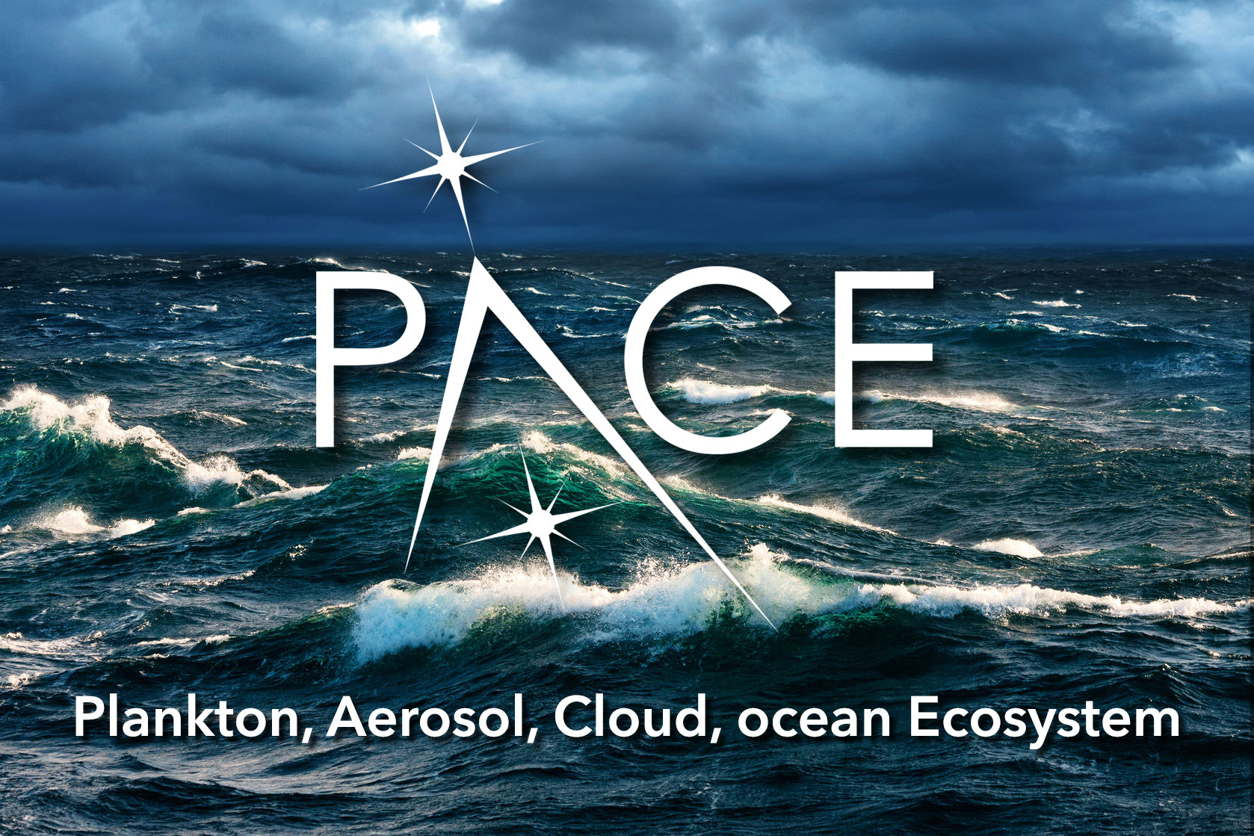
Atmospheric Correction for PACE
Amir Ibrahim
Notes:
Hello welcome to the 2020 PACE applications Workshop. my name is Amir Ibrahim and I'll talk to you today about the atmospheric correction for the PACE mission

Slide 2
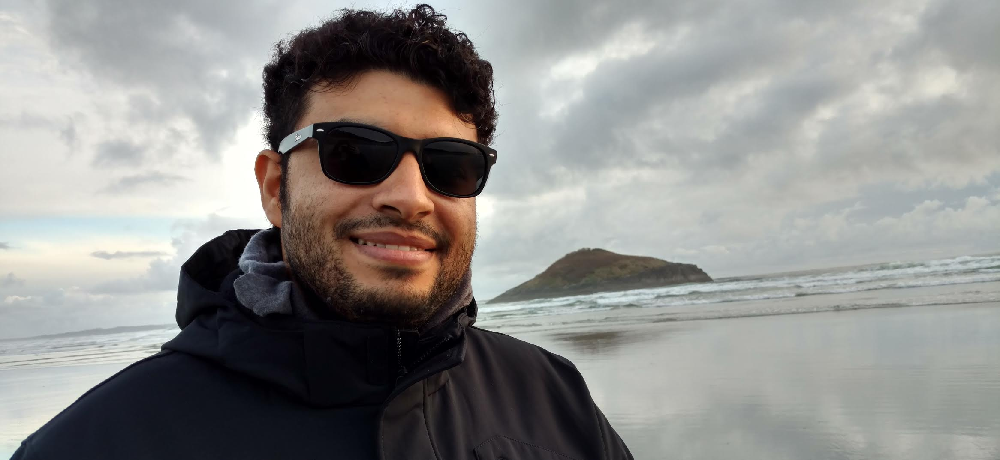
Amir Ibrahim :: amir.ibrahim@nasa.gov PACE Project Science Lead for Atmospheric Correction SSAI/Ocean Ecology Lab, NASA Goddard Ph.D. in Electrical Engineering, the City College of the City University of New York
Polarimetric and hyperspectral remote sensing.
Inversion of the vector radiative transfer equation in the coupled ocean-atmosphere system.
Retrieval of useful optical and microphysical properties of aerosols/hydrosols using the polarization of light.
Improvement of atmospheric correction procedures for ocean color remote sensing.
Notes:
Here I'm giving a little bit of background about myself and my role For the peace mission. I am the lead scientist for the atmospheric Correction of the Ocean color instrument or oci on the PACE satellite. I currently work at the ocean ecology Lab at Nasa Goddard and I have a PhD in electrical engineering from the city University of New York. My main research interests are vector radiative transfer modeling and polarimetric and hyperspectral remote sensing of the ocean. During my PhD work I developed Retrieval algorithms of optical and microphysical properties of hydrosols using the polarized light emerging from beneath the ocean surface. Currently my main focus is on developing advanced atmospheric correction algorithms for the ocean color instrument.

Slide 3
Atmospheric Correction lead role and background
Data Product | Baseline Uncertainty
Water-leaving reflectances centered on (±2.5 nm) 350, 360, and 385 nm (15 nm bandwidth) | 0.0057 or 20%
Water-leaving reflectances centered on (±2.5 nm) 412, 425, 443, 460, 475, 490, 510, 532, 555, and 583 (15 nm bandwidth) | 0.0020 or 5%
Water-leaving reflectances centered on (±2.5 nm) 617, 640, 655, 665 678, and 710 (15 nm bandwidth, except for 10 nm bandwidth for 665 and 678 nm) | 0.0007 or 10%
Atmospheric Correction using OCI alone
Each uncertainty requirement is defined as the maximum of the absolute and relative values for Level-2 satellite data processing (geophysical values in the original satellite coordination system). These requirements are defined for ≥ 50% of the observable deep ocean (≥ 1000 m).
*Better characterization of aerosols using MAP
these are required for mission success & drive OCI design
Additional required products to be generated
Chlorophyll concentration
Spectral diffuse attenuation coefficients
Spectral absorption coefficients (phytoplankton, CDOM+NAP)
Spectral backscattering coefficients
Fluorescence line height
*Polarimetry Lead
Kirk Knobelspiesse
Notes:
The main goal of any atmospheric correction algorithm is to produce the surface reflectance; in our case the water leaving reflectance which is an intermediate product that allows us to produce more interesting geophysical products such as the chlorophyll concentration, the phytoplankton absorption and other relevant inherent Optical properties. My role is to be the Interface between the project science and the science and application team and collaborate to ensure producing the hyperspectral water leaving reflectance at 2.5 nanometer step within the solar Spectrum. As you can see from the table we are required to produce the reflectances within the specified uncertainty. we are required to produce these products using the ocean color in instrument alone however pace will host two Advanced polarimeters that will be able to help us with doing better atmospheric correction.

Slide 4
This simulation used GEOS-5 and the Goddard Chemistry Aerosol Radiation and Transport (GOCART) Model.
AOT
Sea salt Dust Sulfate Organic carbon Black carbon
Notes:
This Movie shows a simulation of the global distribution of aerosols based on the nature run model from the global modeling and assimilation office at Nasa Goddard. These color coded aerosol plumes show the dynamics and complexity of these Airborne particles that can interfere with the ocean signal measured by a satellite sensor at the top of the atmosphere. For example you can see large dust plumes in orange color transported from the Sahara Desert in Africa across the Atlantic Ocean. Also Organic carbon Aerosols produced by biomass burning in central Africa traverse large portions of the Mid-Atlantic. Other aerosols such as sea salt exist everywhere over the ocean. The atmospheric correction process is necessary to separate this dynamic aerosol signal from the top of atmosphere measurements and infer the signal from the ocean which is typically 10% of the total signal measured by satellites in the blue spectrum.

Slide 5
Notes:
Here is another example of real satellite observation measured by VIIRS over the Arabian sea. Looking at this scene you can notice color variations in the ocean where these green swirls are plankton blooms of Noctiluca mixed with diatoms. One of PACE's main science goals is to observe different plankton species by utilizing the hyperspectral capability of OCI. If we compare the plankton absorption of different species retrieved by the multi-spectral VIIRS instrument to the hyperspectral spectral OCI instrument, it can be obvious that OCI will allows us to better retrieve the optical properties of different plankton species because of the rich information content of OCI. However, to retrieve these hyperspectral optical properties, we need an accurate atmospheric correction. Aerosols are not the only varying signal that can interfere with the ocean signal. We also need to correct for surface effects such as the glint and compensate for absorbing gases. We also need to retrieve in complex coastal waters conditions where the highly turbid water interferes with atmospheric correction.

Slide 6
Atmospheric Correction
Molecular scattering removal
Aerosol scattering + absorption correction (black pixel assumption)
Absorbing gases compensation
Surface glint correction
$$H_{2}O$$
$$O_{2}$$
$${CO}_{2}$$
$$CO$$
$${CH}_{4}$$
$$H_{2}O$$
$$H_{2}O$$
$$N_{2}O$$
$$O_{3}$$
$$O_{2}$$
$${CH}_{4}$$
$${CO}_{2}$$
$${NO}_{2}$$
$$H_{2}O$$
$$H_{2}O$$
$$H_{2}O$$
$$H_{2}O$$
AC bands
Notes:
Since this is NASA’s first hyperspectral ocean color mission, we need to develop more advanced algorithms that can handle the additional spectral information from OCI as compared to the heritage multispectral missions. This figure here shows the atmospheric transmittance due to the absorption and scattering of aerosols and molecules. One particular challenge for the hyperspectral atmospheric correction is to properly correct for absorbing gases such as the water vapor, oxygen, ozone and methane. Some of these gases absorb the light in spectral regions in the visible that can make it more challenging to retrieve the plankton species that has similar absorption features to the absorbing gases. Thus a proper compensation of atmospheric gases is important in addition to the molecular and aerosol scattering as well as the glint.

Slide 7
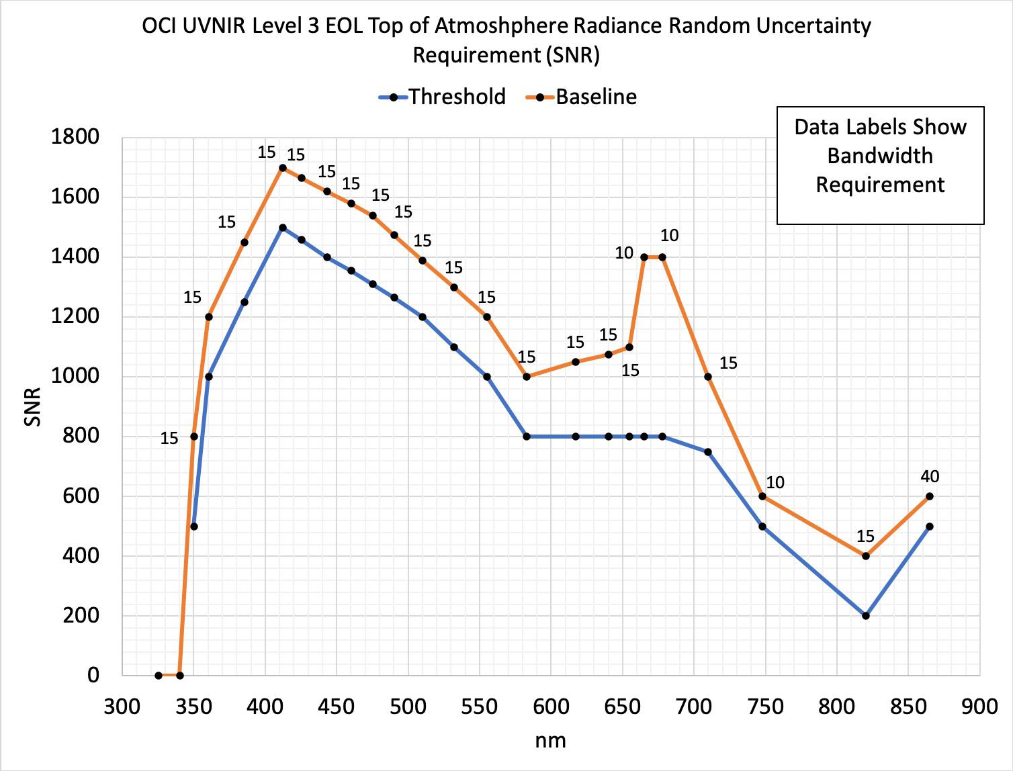
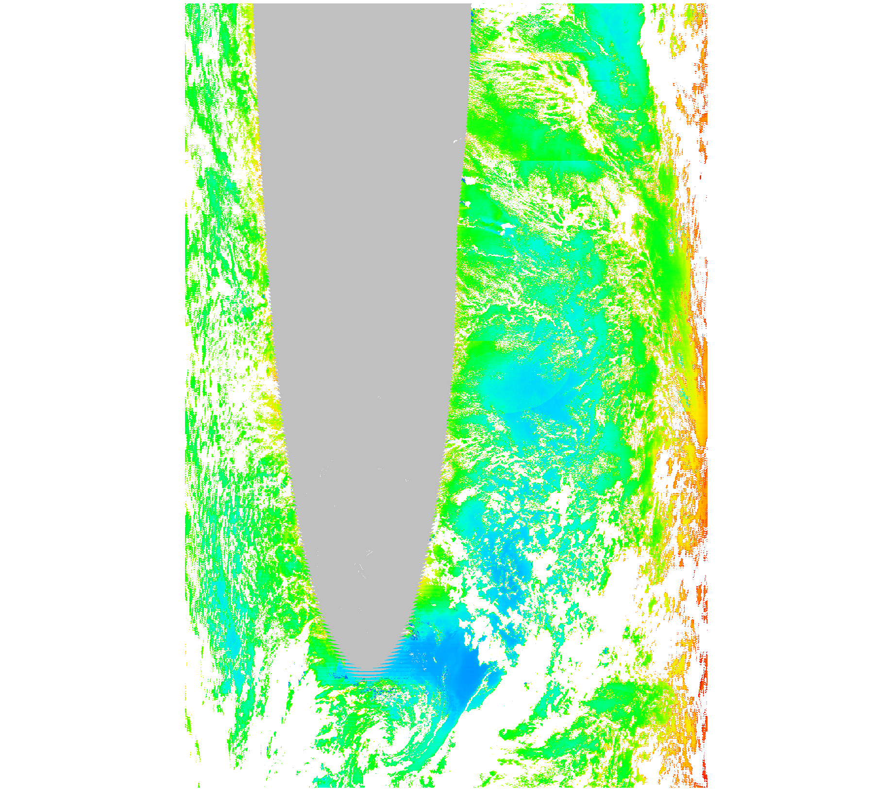
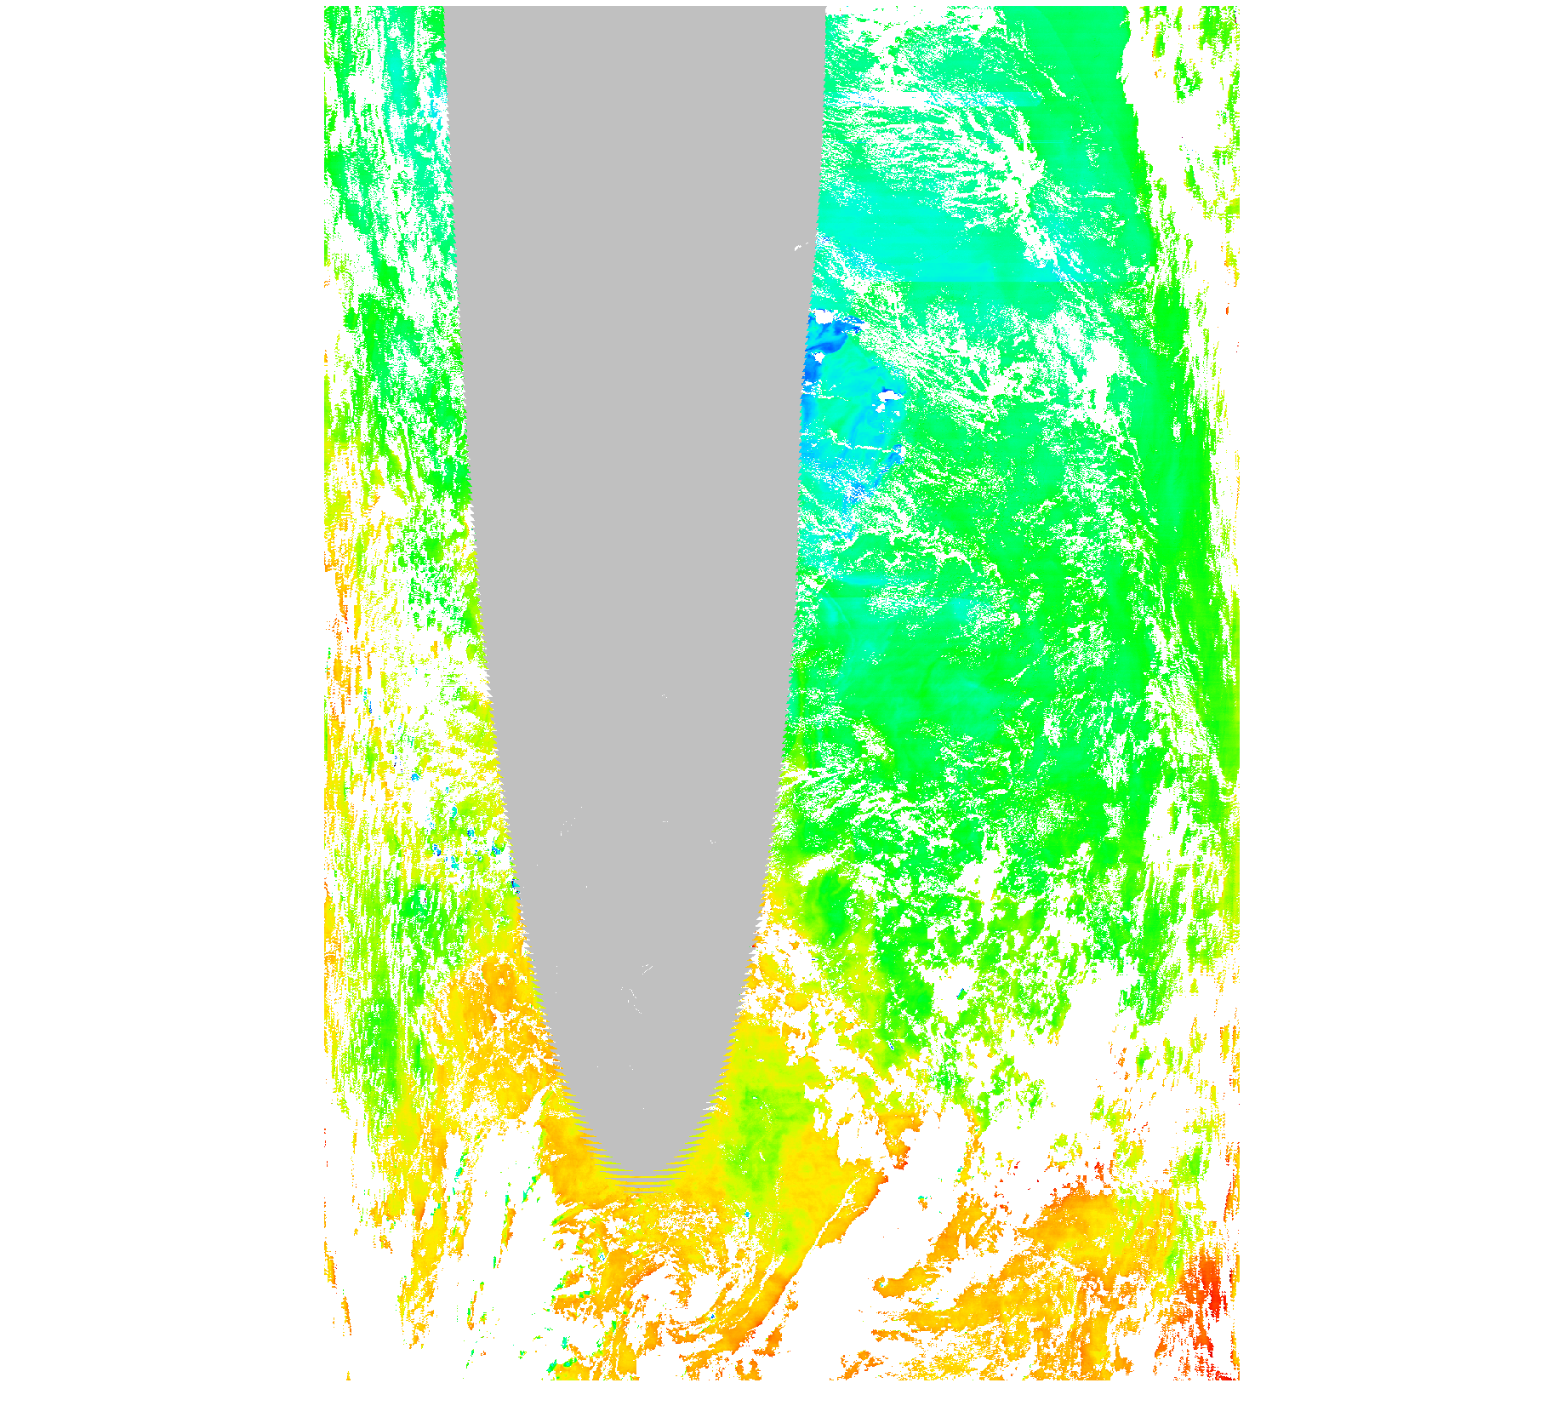
OCI radiometric performance and uncertainty assessment
Surface glint
Rrs(440)
Rrs(440) uncertainty
One goal is to retrieve Rrs_unc_440 < 0.00076 sr-1
Cloud covered pixels
Notes:
The figure on the right hand side shows the signal to noise ratio requirement of OCI in the visible spectrum as well as in the short wave infrared. OCI will have an excellent radiometric performance that will allow us to produce ocean color products with smaller uncertainty. The map on the left hand side is a simulation of what OCI can retrieve from top of atmosphere observations. The simulated scene is based on MODIS Aqua geophysical retrievals translated to hyperspectral wavelengths. Using a pre-launch algorithm dedicated to OCI, we were able to demonstrate that we can process and retrieve the required surface reflectance product Rrs within the required uncertainty. The uncertainty product produced by our level 2 processing algorithm can retrieve the pixel level uncertainty due to random noise and systematic biases. OCI will be the first instrument to have SWIR channels designed for ocean color applications which will reduce the uncertainty from the atmospheric correction in coastal waters.

Slide 8
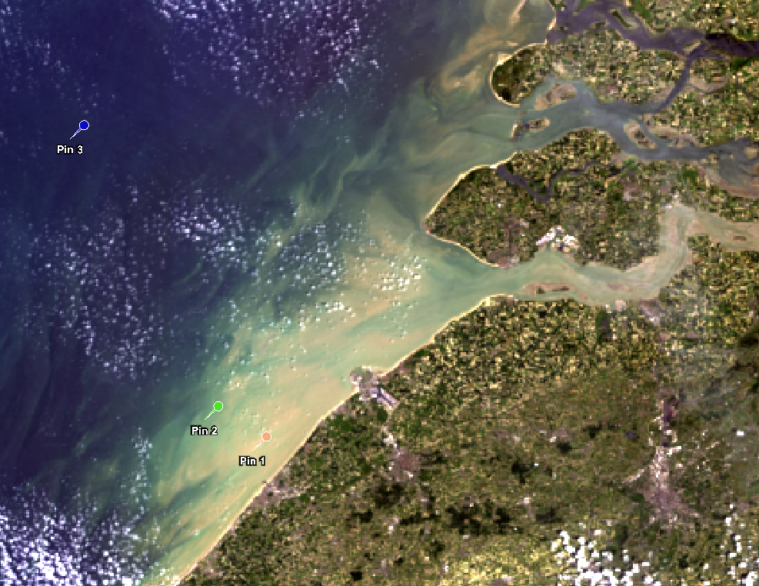
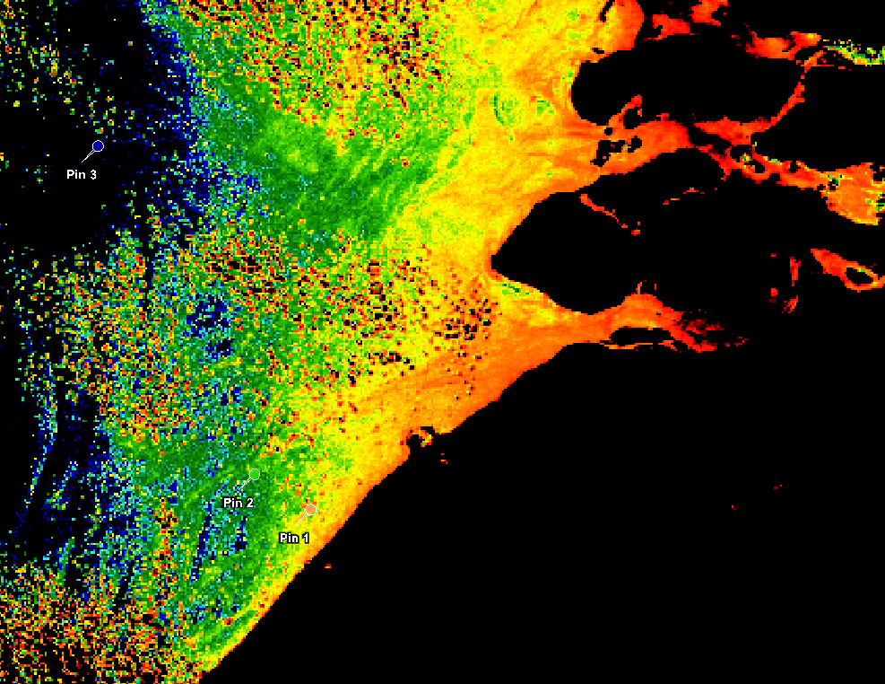
Application and benefits of OCI SWIR channels
(c)
Better Atmospheric Correction in coastal waters.
Better sensitivity to turbidity and less prone to saturation than NIR.
(a)
RGB
~120km
(d)
(b)
OLCI 1020 nm
Knaeps et al. 2015 RSE
Notes:
As I said before, the atmospheric correction over coastal water can be challenging. The atmospheric correction relies on separating the atmospheric signal from the ocean, by inferring the aerosol signal from the longer wavelength where the water absorption is too high, darkening the surface as shown in figure (a) taken from a paper in 2015. Thus the measured signal of the satellite sensor at the longer near infrared or shortwave infrared wavelengths will be coming only from the atmosphere and the surface glint. After characterizing the aerosol and glint spectral dependence in the visible, then we can correct for the total signal to obtain the water reflectance. This method is known as the black pixel algorithm. When the water reflectance is non-negligible as you can see from figure (b), then part of the ocean signal will be attributed to the aerosol thus decreasing the algorithm performance. OCI will have a capable set of SWIR channels that will allow for a better atmospheric correction over turbid and shallow waters. OCI will have a 1038 nm channel similar to the Sentinel-3 OLCI heritage which has 1020 nm band as in figure (c) and (d). The 1038 nm not only will help with the turbid and shallow water atmospheric correction but also can provide better sensitivity to turbidity than near-infrared channels where they can saturate.

Slide 9
OCI tilt to avoid glint and increase coverage
Notes:
Non-tilting sensors such as MODIS or VIIRS lose large parts of their area coverage due to sun glint contamination. OCI will be able to tilt at different parts of the orbit similar to the SeaWiFS heritage to avoid direct sun glint. Since glint contamination is difficult to correct for, OCI tilt will decrease the glint regions thus increasing the ocean color coverage.

Slide 10
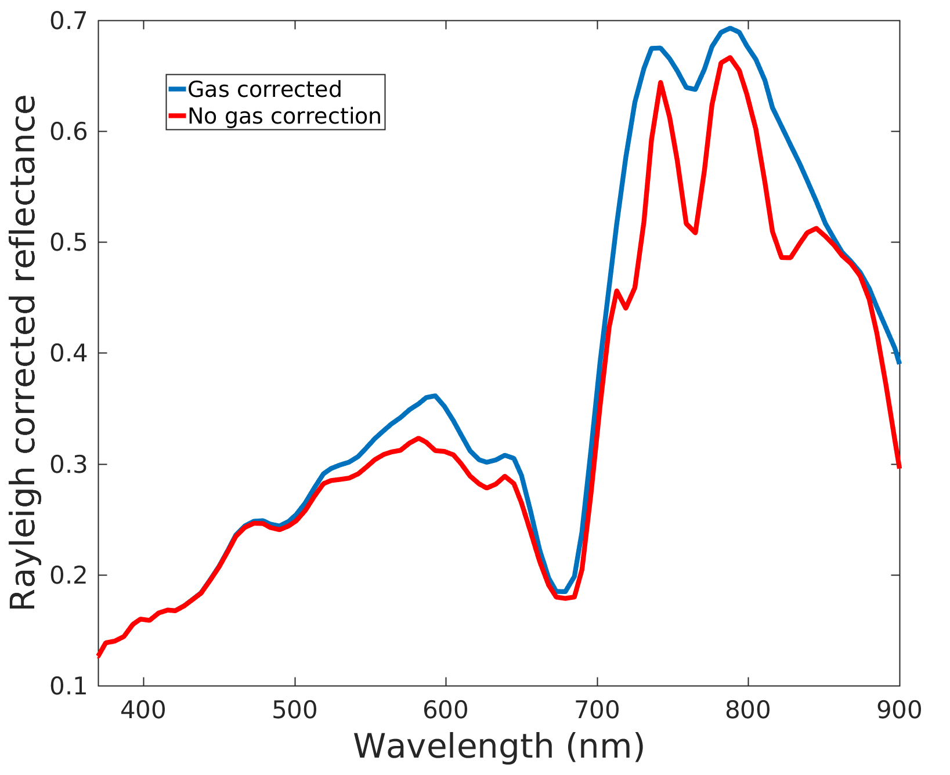
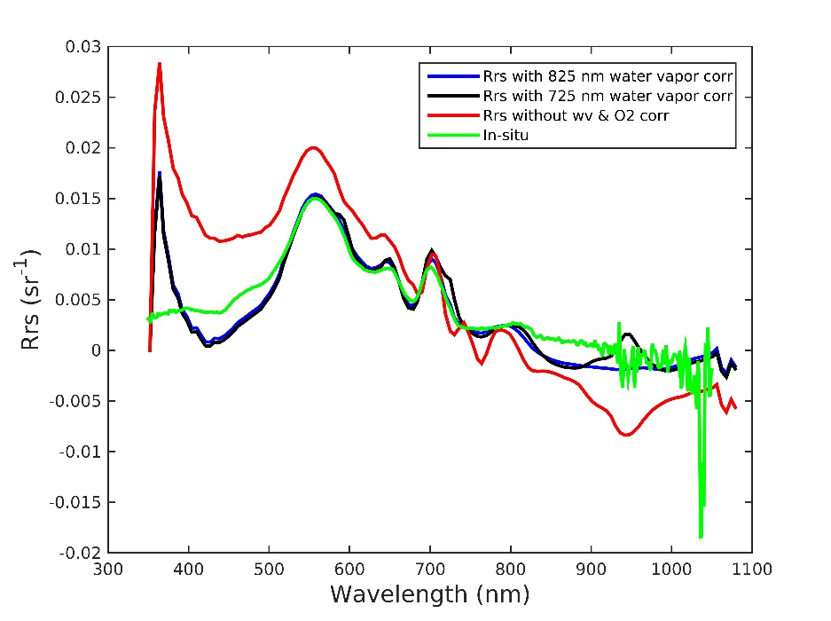
Applications to hyperspectral remote sensing of surface blooms
Lake Erie, USA, Cyanobacteria blooms
Oxygen
Water vapor + ozone + oxygen features
Water vapor
Hyperspectral measurements from OCI can help to distinguish surface blooms of various plankton species.
Detection.
Retrievals.
HICO L2 is processed by OEL and available at https://oceancolor.gsfc.nasa.gov/data/hico/
East Coast of Australia
Notes:
The PACE science and application team relies on OCI proxy data from spaceborne and airborne hyperspectral sensors such as the HICO instrument. HICO can provide interesting case studies such as the ones provided here in this slide. For example, the HICO image on the left side taken over the Australian east coast shows Trichodismium bloom floating over the ocean surface. It is possible to detect these conditions using hyperspectral observations. I am showing here the spectral signal measured by HICO after correcting for the rayleigh scattering only with and without gases correction. I wanted to emphasize that without proper gases correction we can see some spectral features that are coming from the atmosphere and not from the ocean which can cause algorithmic failure when aiming to retrieve surface properties. In a similar demonstration, the HICO image on the right side is taken over Lake Erie in the US where cyanobacteria bloom shows distinct spectral features. Thus a proper hyperspectral atmospheric correction is necessary for inferring the optical properties of the water. Similar to HICO, OCI will be able to detect bloom conditions and provide insight into water quality applications.

Slide 11
GMAO-based OCI simulator
Global geophysical models
Nature Run is a 2-year global, non-hydrostatic mesoscale simulation for the period of June 2005 through May 2007 with a 7 km horizontal resolution. In addition to standard meteorological parameters (wind, temperature, moisture, surface pressure), this simulation includes 15 aerosol tracers (dust, seasalt, sulfate, black and organic carbon), O₃, CO and CO₂.
Output
Geophysical data from NR (atmospheric parameters)
VLIDORT Radiative Transfer
Fully coupled simulations
L1B data:
TOA reflectance
Geophysical data from Watson/Cecile (Ocean radiance)
Orbit simulator
Notes:
Current airborne and spaceborne proxy data can not provide sufficient oceanic and atmospheric conditions for algorithm development, because of limitations in the spectral and spatial coverage. The PACE project science as well as the science and applications team are developing simulated OCI data. The project science team is creating a simulated dataset utilizing NASA Goddard Global Modeling and Assimilation Office Nature Run geophysical model for the atmosphere, coupled with a global ocean water-leaving radiance model to simulate top-of-atmosphere radiance for OCI granules from multiple expected PACE orbits. The TOA radiance is simulated using the vector radiative transfer code VLIDORT. The model accounts for different aerosol types, clouds, and fully couples absorbing gases, such as ozone, water vapor, and oxygen. The ocean radiance is simulated using GMAO’s Ocean-Atmosphere Spectral Irradiance Model that produces global assimilated distributions of ocean’s optical constituents. Land surfaces are also included in the simulation, drawing on MODIS retrieval climatologies. The synthetic data provides a realistic global distribution of expected TOA radiance that OCI can observe, which will facilitate development and testing of OCI pre-launch algorithms across atmosphere, ocean, and land disciplines. The data soon will be available to be distributed to the community.

Slide 12
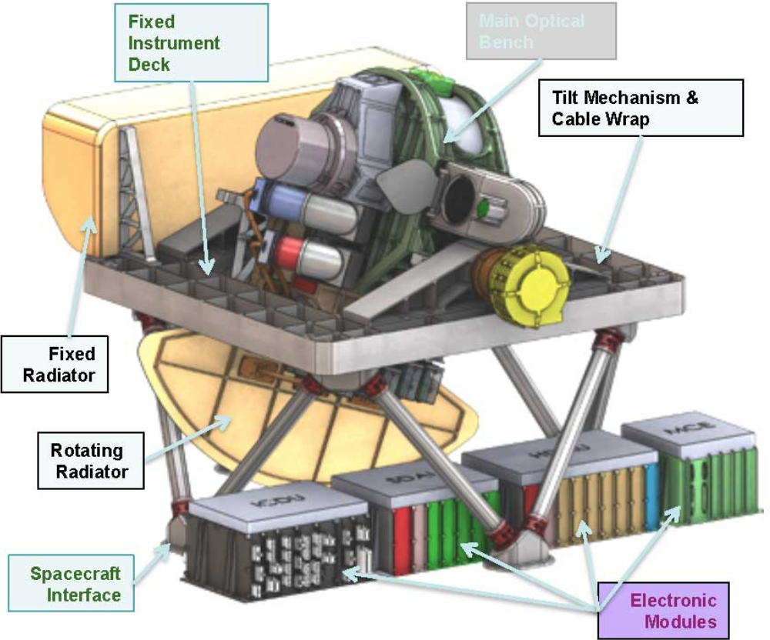
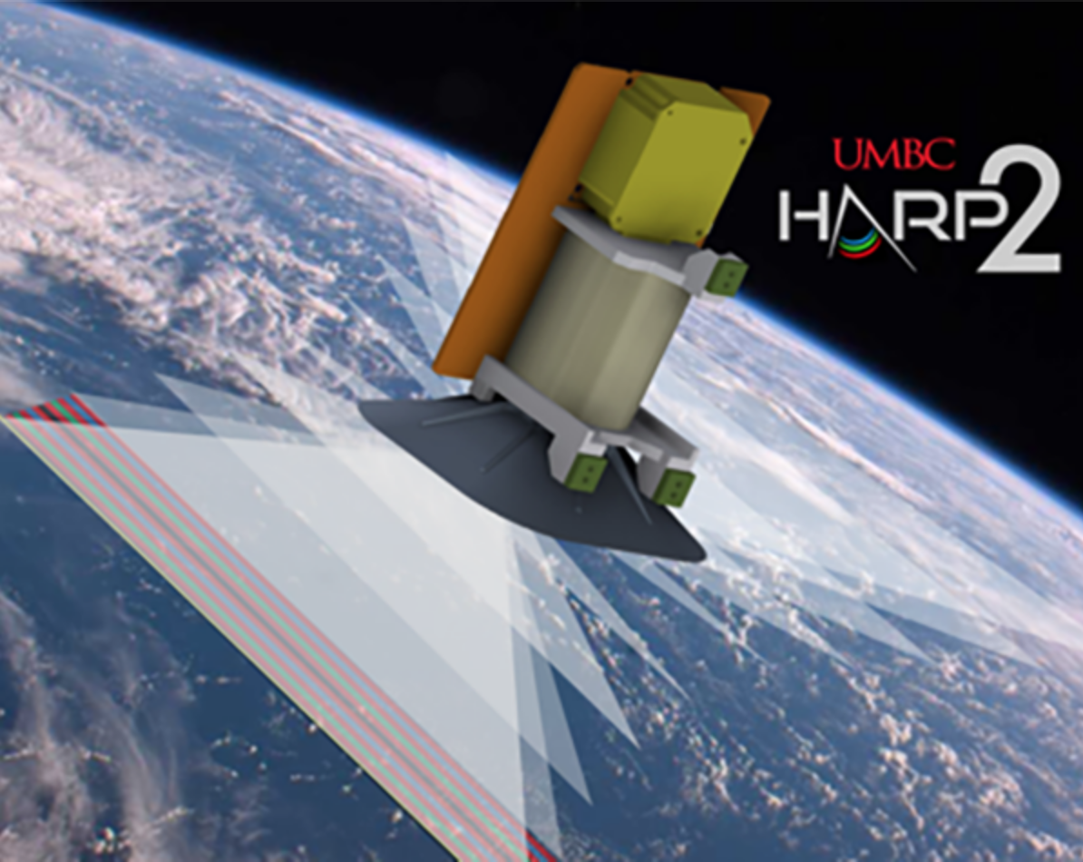
Future outlook!
Thanks for listening!
amir.ibrahim@nasa.gov
OCI
Chlorophyll concentration
Plankton types
Absorption and backscattering
Size distribution
Refractive index
Composition
Separation of organic from non-organic
Beam attenuation
Backscattering fraction
Notes:
With that I would like to thank you for listening. The PACE team is looking forward to working with you in the near future. If you have any questions, please email me. Thank you.

